Slide 1

Memory Utilization Forecast
Ravi Ranjan Singh
Thames Water
<Date>
Notes:
<number>

Slide 2
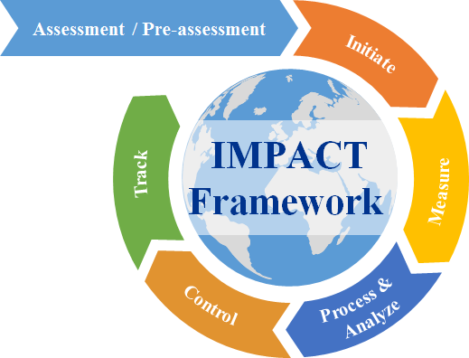
Contents
Initiate - Business Understanding (project charter) #3
Measure - Data Understanding & Data Preparation
Process & Analyze - Modeling
Control - Evaluation
Track - Deployment & Benefits Tracking
Notes:
<number>

Slide 3
#Initiate Phase : Business Understanding – Project Charter
TW account where we have a major volume(average 10 INC/week) of Incident for a memory performance related issue. This performance issues used to hit both application end and as well on infrastructure maintenance jobs which directly hit the end user . We have got a target to look for reduction in performance related INC by 40% in TW Account. We have got a target to finish by Q3 2018.
Goal (what we want to achieve & by when)
Project 1 : Reduction in Memory issue event by 40%
Project 2: Complete the project 1 within a target date Q3.
How do we measure success
- INC Alert reduction for Memory issue
- User raised INC due performance related should reduce
Project Scope
Scope: Automation would helps in improving many areas like producitivty , Availability, Cost reducion and performance
Out Of Scope: Not able to complete the task in a allocated time period
Risks & Dependencies
For implementing this we need to make modification on memory threashold configuration and this changes need to done with proper testing and monitoring
Sponser support needed to proceed with implementation
Notes:
<number>

Slide 4
Project Team
Pooja Yadav ( ITM Team)
Vmware Team
Sponsors
Abhishek Anand- TW SIL
Ganapathy Subramanian Rajamani---FLM
#Initiate Phase : Business Understanding – Project Charter
Voice of Customer -
Standard memory threashold configured on all SQL Server and
Reduce Applcation slowness issue
Voice of Business –
Voice of Process –
Change request process needs to be followed with proper approval from all stakeholder and from business before implementation
Voice of Employee -
Eliminate the waiting time
Tentative Timelines
Initiate – April 9th - April15th 2018
Measure – May 2018
Process & Analyze - June 1st -June 15th 2018
Control - June 16th – June 30th 2018
Track - July-August 2018

Slide 5
#Initiate Phase : Business Understanding – Project Charter
Business Case (Pain point description): XYZ account contract is in the verge of phasing out meaning that the services will slowly be decommissioned constantly and gradually. And, in a month we receive approximately 50+ SSRs for decommission. Each SSRs have a timeline to deliver which we are unable to meet. And, at the same time we could not increase the resources when we are ramping down. On the other hand, a lot of activities are being performed manually and too many touch points established which lead to so much of efforts wasted in non-value adding workload. So, there is a need to do Optimization of the SSR decommission for the XYZ contract.
Goal (what we want to achieve & by when)
To improve the KPI achievement to 95% consistently month on month from November 2017 onwards
How do we measure success
NPS Score improvement on key CX drivers on responsiveness
SLA Adherence
No client escalations
Project Scope
In scope: Automation of possible manual work areas, streamlining too many touch points, improvising the overall efficiency
Out of scope: Adding more resources, renegotiating the KPI with Client
Risks & Dependencies
Dependency on Automation team availability - Sponsor support needed to prioritize the key items
Sample for reference only
Notes:
<number>

Slide 6
Project Team
< DS Participant Name1>
< DS Participant Name2>
<Other team members>
<SMEs>
Project Mentor
< DS Mentor Name>
Sponsors
<PE Name>
<DPE Name>
<SIL Name>
<FLM Name>
#Initiate Phase : Business Understanding – Project Charter
Voice of Customer -
Proper notification on acceptance of SSR
Decommission the server(s) as per the agreed timeline
Proper notification on Decommission confirmation
Voice of Business –
No penalty due to delayed SSR delivery
Less Resource cost in executing SSRs
Voice of Process –
Too many touch points
Third party coordination
Voice of Employee –
Eliminate the non-value adding piece of work
Eliminate the waiting time
Tentative Timelines
Initiate –< 1 week>
Measure – <3 to 4 weeks>
Process & Analyze - <2 weeks>
Control - <2 weeks>
Track - <5 weeks>
Sample for reference only

Slide 7
Thank you
For questions, post on the Data Scientist Slack Channel
https://gts-ibm.slack.com/messages/C9G49D3L2
Notes:
<number>

Slide 8
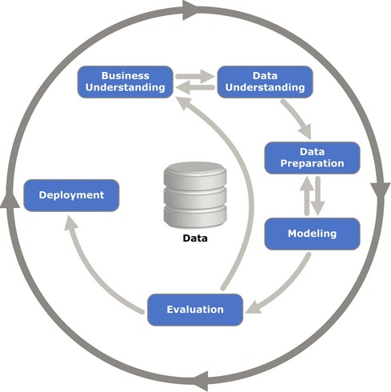
CIC India Data Science Program
Data Science Methodology & Approach
CRISP-DM (IBM Data Science methodology)
Business Understanding – Determine business objective, Assess Situation, Determine Data mining goals, project plan
Data Understanding – Collect initial data, Describe data, Explore Data, Verify Data Quality
Data Preparation – Select data, Clean data, Construct data, Integrate data, Format data
Modeling – Select Modeling techniques, Generate test design, Build model, Assess model
Evaluation – Evaluate results, Review process, Determine next steps
Deployment – Plan deployment, Plan monitoring & maintenance, Product final report & Review Project
Notes:
<number>

